Slide 1
CSE 207: Algorithms
Introduction
Proof By Induction
Asymptotic notation

Slide 2
The Course
Purpose: a rigorous introduction to the design and analysis of algorithms
Not a lab or programming course
Not a math course, either
Textbook: Introduction to Algorithms:: Cormen, Leiserson, Rivest, Stein
An excellent reference you should own
Some additional materials may appear during lectures
use a combination of overhead slides and board
** I appreciate feedback as we go along
** if something is a problem then tell me because it can often be fixed easily

Slide 3
The Course
Instructor: Dr. Mohammad Shahriar Rahman
Assistant Professor, University of Asia Pacific
shahriar.rahman@uap-bd.edu
Office: D 403

Slide 4
Class Schedule (Tentative)
Lecture Number | Contents to be Covered
Lecture 1-3 | Introduction, Sorting, Growth of Functions
Lecture 4-7 | D&C, HT, BST
Lecture 8-10 | Quiz, Dynamic Programming, Greedy Algorithm
Lecture 11-14 | Quiz, Graph Algorithms 1
Lecture 15-18 | Graph Algorithms 2
Lecture 19-21 | Quiz, Number Theory
Lecture 22-23 | Quiz, String Matching, Computational Geometry
Lecture 24-26 | Quiz, NP-Completeness
Lecture 27 | Review

Slide 5
The Course
Class attendance: 5%
In-class Participation: 5%
Quiz: 20%
Mid-term Exam: 20%
Final: 50%
** There will be no make up/retake for quiz
** Only scientific calculators are allowed during exam
** Please keep your cell phone on ‘silent mode’

Slide 6
The Course
Format
Two lectures/week
Homework (may be)
5 quizzes; avg of best 4

Slide 7
Course Objectives
This course introduces students to the analysis and design of computer algorithms. Upon completion of this course, students will be able to do the following:
Analyze the asymptotic performance of algorithms.
Demonstrate a familiarity with major algorithms and data structures.
Apply important algorithmic design paradigms and methods of analysis.
Synthesize efficient algorithms in common engineering design situations.

Slide 8
What is Algorithm?
Algorithm
is any well-defined computational procedure that takes some value, or set of values, as input and produces some value, or set of values, as output.
is thus a sequence of computational steps that transform the input into the output.
is a tool for solving a well - specified computational problem.
Any special method of solving a certain kind of problem (Webster Dictionary)

Slide 9
What is a program?
A program is the expression of an algorithm in a programming language
a set of instructions which the computer will follow to solve a problem

Slide 10
Where We're Going (1/2)
Learn general approaches to algorithm design
Divide and conquer
Greedy method
Dynamic Programming
Basic Search and Traversal Technique
Graph Theory
Number Theoretic Approach
NP Problem

Slide 11
Where We're Going(2/2)
Examine methods of analyzing algorithm correctness and efficiency
Lower bound techniques
O,Omega and Theta notations for best/worst/average case analysis
Decide whether some problems have no solution in reasonable time
List all permutations of n objects (takes n! steps)
Travelling salesman problem
Investigate memory usage as a different measure of efficiency

Slide 12
Some Application
These techniques can be applied to
Critical thinking/analysis
Data retrieval/mining
Network routing
Games
Security
etc

Slide 13
The study of Algorithm
How to devise algorithms
How to express algorithms
How to validate algorithms
How to analyze algorithms
How to test a program

Slide 14
Importance of Analyzing Algorithm
Need to recognize limitations of various algorithms for solving a problem
Need to understand relationship between problem size and running time
When is a running program not good enough?
Need to learn how to analyze an algorithm's running time without coding it
Need to learn techniques for writing more efficient code
Need to recognize bottlenecks in code as well as which parts of code are easiest to optimize

Slide 15
Why do we analyze about them?
understand their behavior, and (Job -- Selection, performance, modify)
improve them. (Research)

Slide 16
What do we analyze about them?
Correctness
Does the input/output relation match algorithm requirement?
Amount of work done (aka complexity)
Basic operations to do task
Amount of space used
Memory used

Slide 17
What do we analyze about them?
Simplicity, clarity
Verification and implementation.
Optimality
Is it impossible to do better?

Slide 18
Complexity
The complexity of an algorithm is simply the amount of work the algorithm performs to complete its task.

Slide 19
RAM model
has one processor
executes one instruction at a time
each instruction takes "unit time“
has fixed-size operands, and
has fixed size storage (RAM and disk).

Slide 20
Why study algorithms and performance?
Algorithms help us to understand scalability.
Performance often draws the line between what is feasible and what is impossible.
Algorithmic mathematics provides a language for talking about program behavior.
Performance is the currency of computing.
The lessons of program performance generalize to other computing resources.

Slide 21
The Selection Problem (1/2)
Problem: given a group of n numbers, determine the k^{th} largest
Algorithm 1
Store numbers in an array
Sort the array in descending order
Return the number in position k

Slide 22
The Selection Problem(2/2)
Algorithm 2
Store first k numbers in an array
Sort the array in descending order
For each remaining number, if the number is larger than the k^{th} number, insert the number in the correct position of the array
Return the number in position k
Which algorithm is better?

Slide 23
Example: What is an Algorithm?
Problem: Input is a sequence of integers stored in an array.
Output the minimum.
INPUT
Algorithm
OUTPUT
instance
m:= a[1];
for I:=2 to size of input
if m > a[I] then m:=a[I];
return s
25, 90, 53, 23, 11, 34
11
m
Data-Structure

Slide 24
Define Problem
Problem:
Description of Input-Output relationship
Algorithm:
A sequence of computational step that transform the input into the output.
Data Structure:
An organized method of storing and retrieving data.
Our task:
Given a problem, design a correct and good algorithm that solves it.

Slide 25
Example Algorithm
Sort the input in increasing order. Return the
first element of the sorted data.
34
6
5
9
20
8
11
7
black
box
Sorting
5
6
7
8
9
11
20
34

Slide 26
Which algorithm is better?
The algorithms are correct, but which is the best?
Measure the running time (number of operations needed).
Measure the amount of memory used.
Note that the running time of the algorithms increase as the size of the input increases.

Slide 27
What do we need?
Correctness: Whether the algorithm computes
the correct solution for all instances
Efficiency: Resources needed by the algorithm
1. Time: Number of steps.
2. Space: amount of memory used.
Measurement “model”: Worst case, Average case
and Best case.

Slide 28
Methods of Proof
Proof by Contradiction
Assume a theorem is false; show that this assumption implies a property known to be true is false -- therefore original hypothesis must be true
Proof by Counterexample
Use a concrete example to show an inequality cannot hold
Mathematical Induction
Prove a trivial base case, assume true for k, then show hypothesis is true for k+1
Used to prove recursive algorithms

Slide 29
What is Algorithm Analysis?
How to estimate the time required for an algorithm
Techniques that drastically reduce the running time of an algorithm
A mathemactical framwork that more rigorously describes the running time of an algorithm

Slide 30
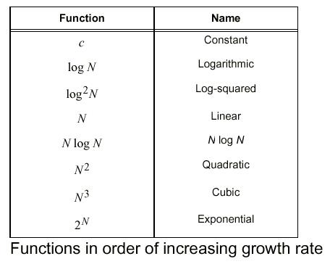
Function of Growth rate

Slide 31
Review: Induction
Suppose
S(k) is true for fixed constant k
Often k = 0
S(n) → S(n+1) for all n >= k
Then S(n) is true for all n >= k

Slide 32
Proof By Induction
Claim:S(n) is true for all n >= k
Basis:
Show formula is true when n = k
Inductive hypothesis:
Assume formula is true for an arbitrary n
Step:
Show that formula is then true for n+1

Slide 33
Induction Example: Gaussian Closed Form
Prove 1 + 2 + 3 + … + n = n(n+1) / 2
Basis:
If n = 0, then 0 = 0(0+1) / 2
Inductive hypothesis:
Assume 1 + 2 + 3 + … + n = n(n+1) / 2
Step (show true for n+1):
1 + 2 + … + n + n+1 = (1 + 2 + …+ n) + (n+1)
= n(n+1)/2 + n+1 = [n(n+1) + 2(n+1)]/2
= (n+1)(n+2)/2 = (n+1)(n+1 + 1) / 2

Slide 34
Induction Example: Geometric Closed Form
Prove a⁰ + a¹ + … + a^{n} = (a^{n+1} - 1)/(a - 1) for all a ≠ 1

Slide 35
Induction
Strong induction also holds
Basis: show S(0)
Hypothesis: assume S(k) holds for arbitrary k <= n
Step: Show S(n+1) follows
Another variation:
Basis: show S(0), S(1)
Hypothesis: assume S(n) and S(n+1) are true
Step: show S(n+2) follows

Slide 36
Asymptotic Performance
In this course, we care most about asymptotic performance
How does the algorithm behave as the problem size gets very large?
Running time
Memory/storage requirements
Bandwidth/power requirements/logic gates/etc.

Slide 37
Asymptotic Notation
By now you should have an intuitive feel for asymptotic (big-O) notation:
What does O(n) running time mean? O(n²)? O(n lg n)?
How does asymptotic running time relate to asymptotic memory usage?
Our first task is to define this notation more formally and completely

Slide 38
Analysis of Algorithms
Analysis is performed with respect to a computational model
We will usually use a generic uniprocessor random-access machine (RAM)
All memory equally expensive to access
No concurrent operations
All reasonable instructions take unit time
Except, of course, function calls
Constant word size
Unless we are explicitly manipulating bits

Slide 39
Input Size
Time and space complexity
This is generally a function of the input size
E.g., sorting, multiplication
How we characterize input size depends:
Sorting: number of input items
Multiplication: total number of bits
Graph algorithms: number of nodes & edges
Etc

Slide 40
Running Time
Number of primitive steps that are executed
Except for time of executing a function call most statements roughly require the same amount of time
y = m * x + b
c = 5 / 9 * (t - 32 )
z = f(x) + g(y)
We can be more exact if need be

Slide 41
Analysis
Worst case
Provides an upper bound on running time
An absolute guarantee
Average case
Provides the expected running time
Very useful, but treat with care: what is “average”?
Random (equally likely) inputs
Real-life inputs

Slide 42
Review: Asymptotic Performance
Asymptotic performance: How does algorithm behave as the problem size gets very large?
Running time
Memory/storage requirements
Remember that we use the RAM model:
All memory equally expensive to access
No concurrent operations
All reasonable instructions take unit time
Except, of course, function calls
Constant word size
Unless we are explicitly manipulating bits

Slide 43
Review: Running Time
Number of primitive steps that are executed
Except for time of executing a function call most statements roughly require the same amount of time
We can be more exact if need be
Worst case vs. average case

Slide 44
An Example: Insertion Sort
InsertionSort(A, n) { for i = 2 to n { key = A[i] j = i - 1; while (j > 0) and (A[j] > key) { A[j+1] = A[j] j = j - 1 } A[j+1] = key }
}

Slide 45
Insertion Sort
InsertionSort(A, n) { for i = 2 to n { key = A[i] j = i - 1; while (j > 0) and (A[j] > key) { A[j+1] = A[j] j = j - 1 } A[j+1] = key }
}
How many times will this loop execute?

Slide 46
Insertion Sort
Statement Effort
InsertionSort(A, n) {
for i = 2 to n { c₁n
key = A[i] c₂(n-1)
j = i - 1; c₃(n-1)
while (j > 0) and (A[j] > key) { c₄T
A[j+1] = A[j] c₅(T-(n-1))
j = j - 1 c₆(T-(n-1))
} 0
A[j+1] = key c₇(n-1)
} 0
}
T = t₂ + t₃ + … + t_{n} where t_{i} is number of while expression evaluations for the i^{th} for loop iteration

Slide 47
Analyzing Insertion Sort
T(n) = c₁n + c₂(n-1) + c₃(n-1) + c₄T + c₅(T - (n-1)) + c₆(T - (n-1)) + c₇(n-1)
What can T be?
Best case -- inner loop body never executed
t_{i} = 1 ➔ T(n) is a linear function
Worst case -- inner loop body executed for all previous elements
t_{i} = i ➔ T(n) is a quadratic function

Slide 48
Analysis
Simplifications
Ignore actual and abstract statement costs
Order of growth is the interesting measure:
Highest-order term is what counts
Remember, we are doing asymptotic analysis
As the input size grows larger it is the high order term that dominates

Slide 49
Upper Bound Notation
We say InsertionSort’s run time is O(n²)
Properly we should say run time is in O(n²)
Read O as “Big-O” (you’ll also hear it as “order”)
In general a function
f(n) is O(g(n)) if there exist positive constants c and n₀ such that f(n) ≤ c ⋅ g(n) for all n ≥ n₀
Formally
O(g(n)) = { f(n): ∃ positive constants c and n₀ such that f(n) ≤ c ⋅ g(n) ∀ n ≥ n₀

Slide 50
Insertion Sort Is O(n²)
Proof
Suppose runtime is an² + bn + c
If any of a, b, and c are less than 0 replace the constant with its absolute value
an² + bn + c ≤ (a + b + c)n² + (a + b + c)n + (a + b + c)
≤ 3(a + b + c)n² for n ≥ 1
Let c’ = 3(a + b + c) and let n₀ = 1

Slide 51
Big O Fact
A polynomial of degree k is O(n^{k})
Proof:
Suppose f(n) = b_{k}n^{k} + b_{k-1}n^{k-1} + … + b₁n + b₀
Let a_{i} = | b_{i} |
f(n) ≤ a_{k}n^{k} + a_{k-1}n^{k-1} + … + a₁n + a₀

Slide 52
Lower Bound Notation
We say InsertionSort’s run time is Ω(n)
In general a function
f(n) is Ω(g(n)) if ∃ positive constants c and n₀ such that 0 ≤ c⋅g(n) ≤ f(n) ∀ n ≥ n₀
Proof:
Suppose run time is an + b
Assume a and b are positive (what if b is negative?)
an ≤ an + b

Slide 53
Asymptotic Tight Bound
A function f(n) is Θ(g(n)) if ∃ positive constants c₁, c₂, and n₀ such that c₁ g(n) ≤ f(n) ≤ c₂ g(n) ∀ n ≥ n₀
Theorem
f(n) is Θ(g(n)) iff f(n) is both O(g(n)) and Ω(g(n))
Proof: someday

Slide 54
Other Asymptotic Notations
A function f(n) is o(g(n)) if ∃ positive constants c and n₀ such that f(n) < c g(n) ∀ n ≥ n₀
A function f(n) is ω(g(n)) if ∃ positive constants c and n₀ such that c g(n) < f(n) ∀ n ≥ n₀
Intuitively,
o() is like <
O() is like ≤
ω() is like >
Ω() is like ≥
Θ() is like =

Slide 55
Asymptotic Notation, Review of Functions & Summations

Slide 56
Asymptotic Complexity
Running time of an algorithm as a function of input size n for large n.
Expressed using only the highest-order term in the expression for the exact running time.
Instead of exact running time, say Θ(n²).
Describes behavior of function in the limit.
Written using Asymptotic Notation.

Slide 57
Asymptotic Notation
Θ, O, Ω, o, ω
Defined for functions over the natural numbers.
Ex: f(n) = Θ(n²).
Describes how f(n) grows in comparison to n².
Define a set of functions; in practice used to compare two function sizes.
The notations describe different rate-of-growth relations between the defining function and the defined set of functions.

Slide 58
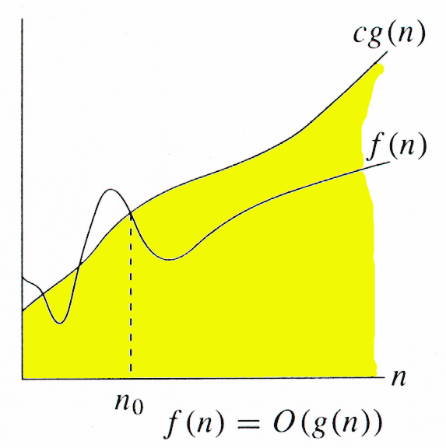
O-notation
For function g(n), we define O(g(n)), big-O of n, as the set:
O(g(n)) = {f(n) : ∃ positive constants c and n_{0,} such that ∀n ≥ n₀,
we have 0 ≤ f(n) ≤ cg(n) }
Intuitively: Set of all functions whose rate of growth is the same as or lower than that of g(n).
g(n) is an asymptotic upper bound for f(n).

Slide 59
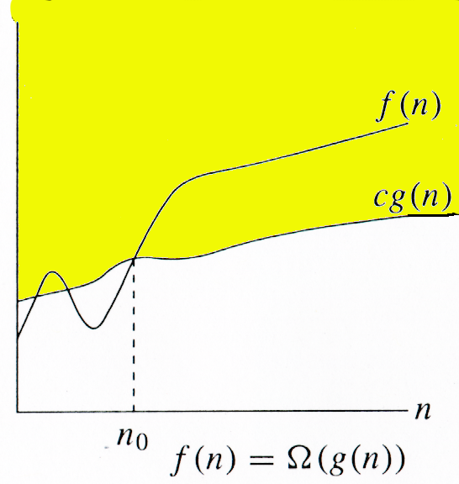
Ω -notation
For function g(n), we define Ω(g(n)), big-Omega of n, as the set:
Ω(g(n)) = {f(n) : ∃ positive constants c and n_{0,} such that ∀n ≥ n₀,
we have 0 ≤ cg(n) ≤ f(n)}
Intuitively: Set of all functions whose rate of growth is the same as or higher than that of g(n).
g(n) is an asymptotic lower bound for f(n).

Slide 60
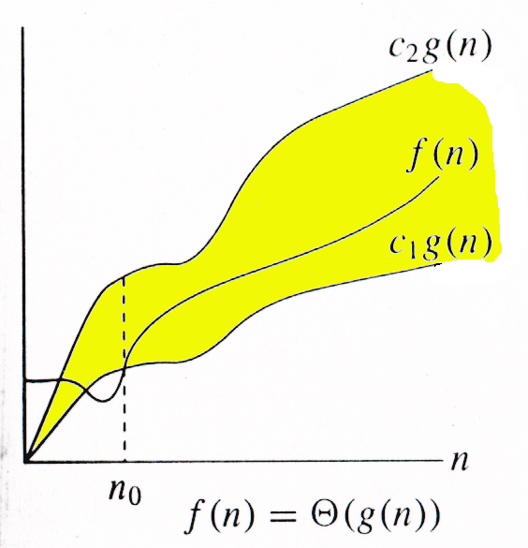
Θ-notation
For function g(n), we define Θ(g(n)), big-Theta of n, as the set:
Θ(g(n)) = {f(n) : ∃ positive constants c₁, c₂, and n_{0,} such that ∀n ≥ n₀,
we have 0 ≤ c₁g(n) ≤ f(n) ≤ c₂g(n)
}
Intuitively: Set of all functions that
have the same rate of growth as g(n).
g(n) is an asymptotically tight bound for f(n).

Slide 61
Θ-notation
For function g(n), we define Θ(g(n)), big-Theta of n, as the set:
Θ(g(n)) = {f(n) : ∃ positive constants c₁, c₂, and n_{0,} such that ∀n ≥ n₀,
we have 0 ≤ c₁g(n) ≤ f(n) ≤ c₂g(n)
}
Technically, f(n) ∈ Θ(g(n)).
f(n) and g(n) are nonnegative, for large n.
f(n) = Θ(g(n)) ⇒ f(n) = O(g(n)).
Θ(g(n)) ⊂ O(g(n)).
f(n) = Θ(g(n)) ⇒ f(n) = Ω(g(n)).
Θ(g(n)) ⊂ Ω(g(n)).

Slide 62
Example
Θ(g(n)) = {f(n) : ∃ positive constants c₁, c₂, and n₀, such that ∀n ≥ n₀, 0 ≤ c₁g(n) ≤ f(n) ≤ c₂g(n)}
10n² - 3n = Θ(n²)
What constants for n₀, c₁, and c₂ will work?
Make c₁ a little smaller than the leading coefficient, and c₂ a little bigger.
To compare orders of growth, look at the leading term.

Slide 63
Relations Among Θ, O, Ω

Slide 64
Relations Between Θ, Ω, O
Theorem : For any two functions g(n) and f(n), f(n) = Θ(g(n)) iff
f(n) = O(g(n)) and f(n) = Ω(g(n)).
I.e., Θ(g(n)) = O(g(n)) ∩ Ω(g(n))
In practice, asymptotically tight bounds are obtained from asymptotic upper and lower bounds.

Slide 65
Running Times
“Running time is O(f(n))” ⇒ Worst case is O(f(n))
O(f(n)) bound on the worst-case running time ⇒ O(f(n)) bound on the running time of every input.
Θ(f(n)) bound on the worst-case running time ⇒ Θ(f(n)) bound on the running time of every input.
“Running time is Ω(f(n))” ⇒ Best case is Ω(f(n))
Can still say “Worst-case running time is Ω(f(n))”
Means worst-case running time is given by some unspecified function g(n) ∈ Ω(f(n)).

Slide 66
Asymptotic Notation in Equations
Can use asymptotic notation in equations to replace expressions containing lower-order terms.
For example,
4n³ + 3n² + 2n + 1 = 4n³ + 3n² + Θ(n)
= 4n³ + Θ(n²) = Θ(n³). How to interpret?
In equations, Θ(f(n)) always stands for an anonymous function g(n) ∈ Θ(f(n))
In the example above, Θ(n²) stands for 3n² + 2n + 1.

Slide 67
o-notation
For a given function g(n), the set little-o:
o(g(n)) = {f(n): ∀ c > 0, ∃ n₀ > 0 such that ∀ n ≥ n₀, we have 0 ≤ f(n) < cg(n)}.
f(n) becomes insignificant relative to g(n) as n approaches infinity:
lim [f(n) / g(n)] = 0
^{n→∞}
g(n) is an upper bound for f(n) that is not asymptotically tight.

Slide 68
ω -notation
For a given function g(n), the set little-omega:
ω(g(n)) = {f(n): ∀ c > 0, ∃ n₀ > 0 such that ∀ n ≥ n₀, we have 0 ≤ cg(n) < f(n)}.
f(n) becomes arbitrarily large relative to g(n) as n approaches infinity:
lim [f(n) / g(n)] = ∞.
^{n→∞}
g(n) is a lower bound for f(n) that is not asymptotically tight.

Slide 69
Comparison of Functions
f ↔ g ≈ a ↔ b
f (n) = O(g(n)) ≈ a ≤ b
f (n) = Ω(g(n)) ≈ a ≥ b
f (n) = Θ(g(n)) ≈ a = b
f (n) = o(g(n)) ≈ a < b
f (n) = ω (g(n)) ≈ a > b

Slide 70
Properties
Transitivity
f(n) = Θ(g(n)) & g(n) = Θ(h(n)) ⇒ f(n) = Θ(h(n))
f(n) = O(g(n)) & g(n) = O(h(n)) ⇒ f(n) = O(h(n))
f(n) = Ω(g(n)) & g(n) = Ω(h(n)) ⇒ f(n) = Ω(h(n))
f(n) = o (g(n)) & g(n) = o (h(n)) ⇒ f(n) = o (h(n))
f(n) = ω(g(n)) & g(n) = ω(h(n)) ⇒ f(n) = ω(h(n))
Reflexivity
f(n) = Θ(f(n))
f(n) = O(f(n))
f(n) = Ω(f(n))

Slide 71
Properties
Symmetry
f(n) = Θ(g(n)) iff g(n) = Θ(f(n))
Complementarity
f(n) = O(g(n)) iff g(n) = Ω(f(n))
f(n) = o(g(n)) iff g(n) = ω((f(n))

